Slide 1
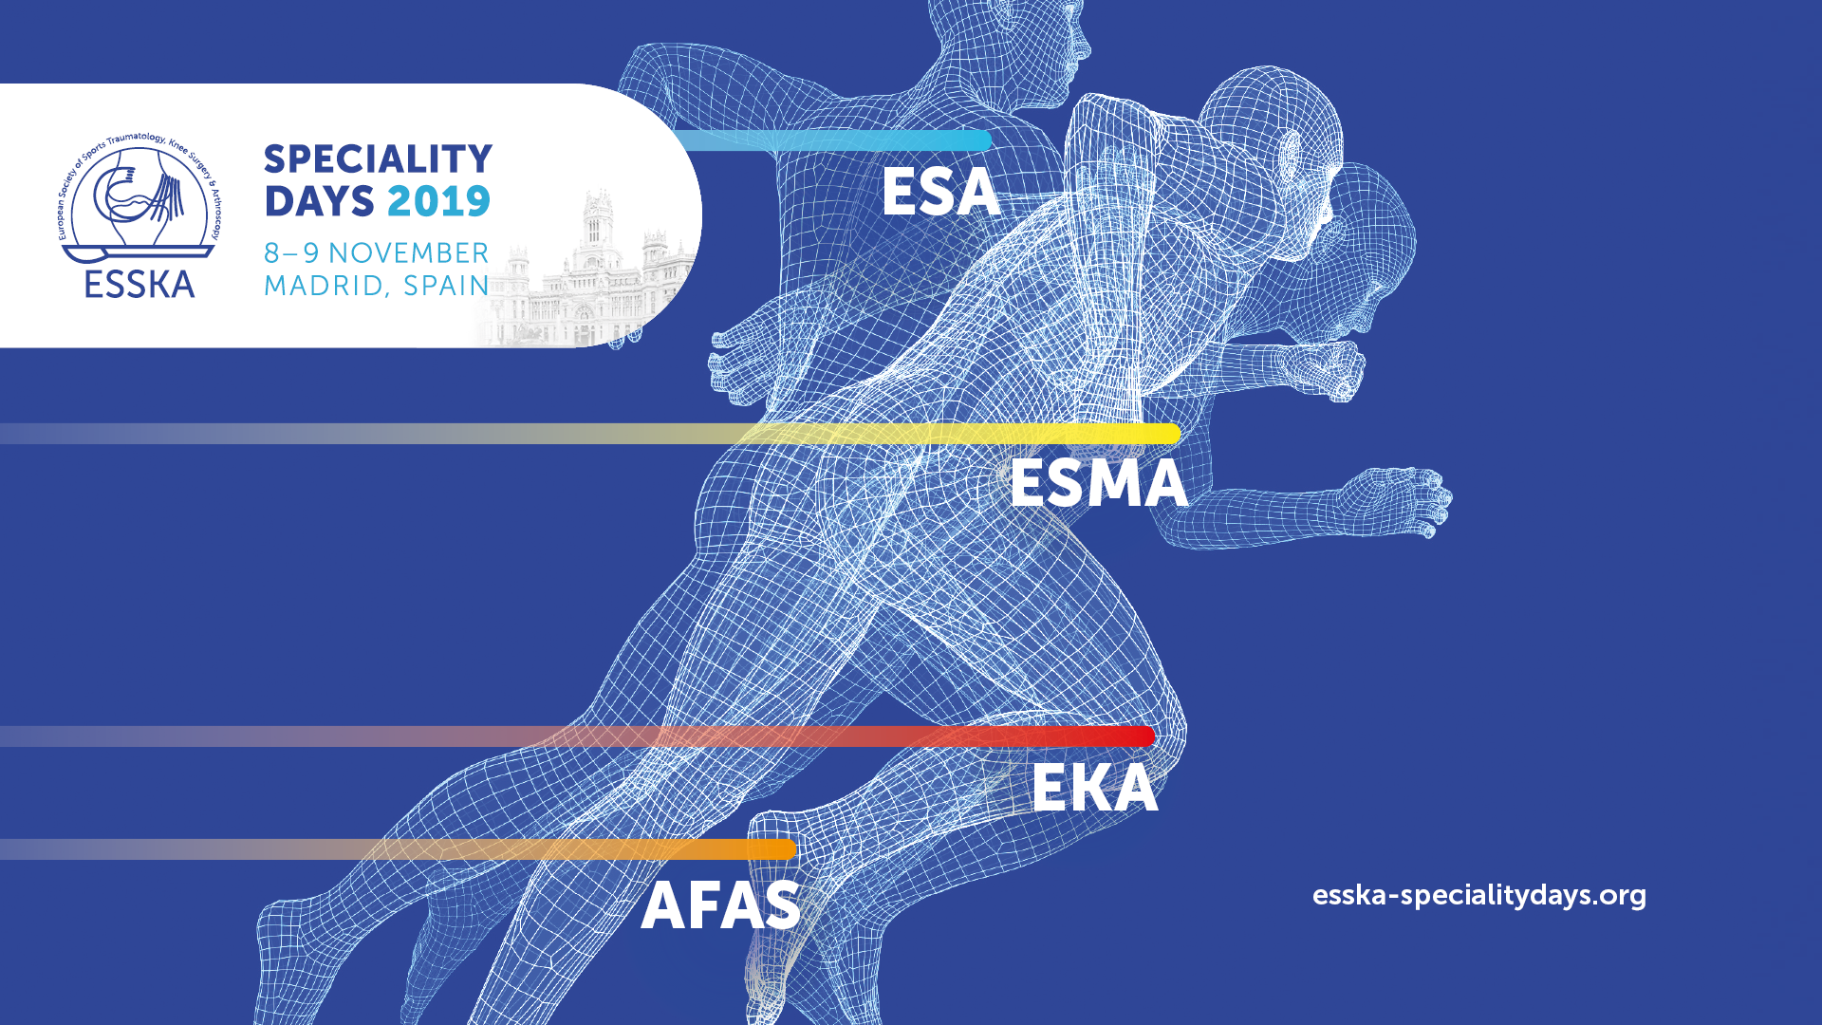

Slide 2
FROM TRAUMA TO ARTHRITIS –
WHERE DO WE STAND

